Slide 1
SUPER STORE SALES DASHBOARD

Slide 2
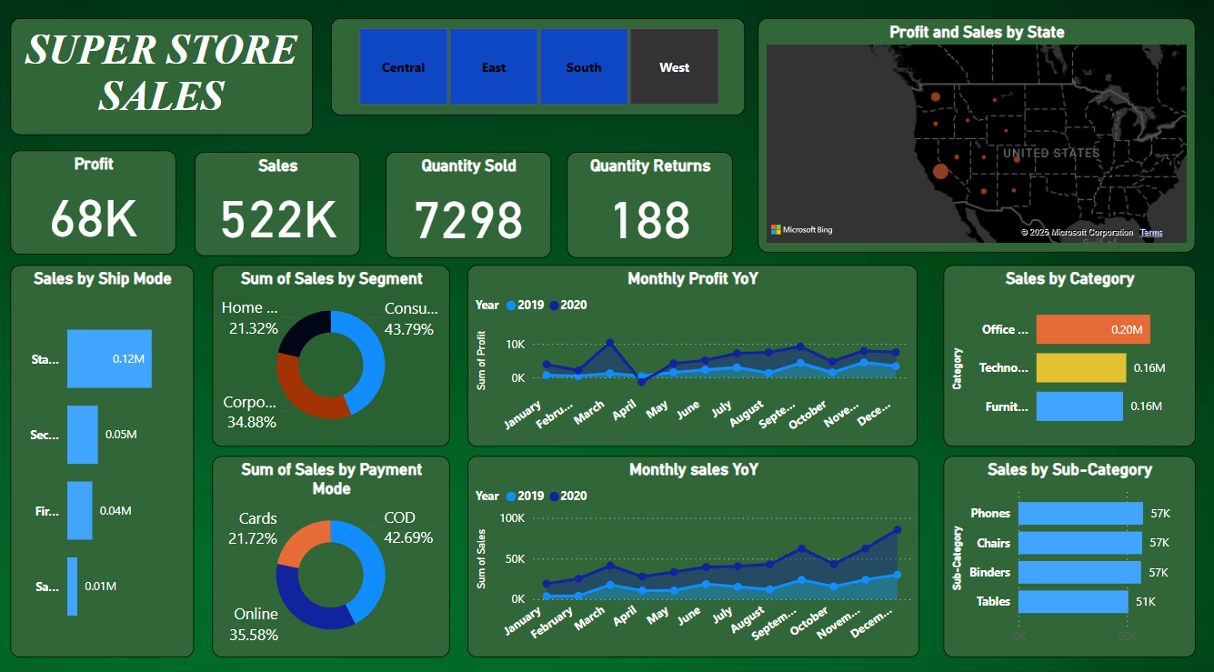
DASHBOARD

Slide 3
OVERVIEW OF THE DASHBOARD
Developed an interactive dashboard with actionable insights.
Cleaned the data, removed duplicate and null values from the data.
Removed columns which were not needed for the dashboard.
Explained the insights to the stake holders to get a overview of the dashboard.

Slide 4
KEY INSIGHTS
The West Region is having the highest sales of 522K and profit of 68000.
The highest monthly YOY sakes in 2019 and 2020 was in the December and lowest in January.
COD has the highest sales by Payment mode in all the regions.
Standard Class has the highest sales by Shipping Mode.
Consumer Segment has the highest sales.
Office supplies has the highest sales by category.
Chairs has the highest sales in sub-category.
Highest quantities were returned in the West region.

Slide 5
Monthly YOY profit for 2019 and 2020
REGION | SALES
EAST | HIGHEST IN NOVEMBER 2020
WEST | HIGHEST IN MARCH 2020
NORTH | HIGHEST IN OCTOBER 2019
SOUTH | HIGHEST IN FEBRUARY 2019

